Slide 1

SECP3623 DATABASE PROGRAMMING
TOPIC 1 - INTRODUCTION

Slide 2
LECTURE LEARNING OUTCOME
By the end of this lecture, students should be able to:
01
Understand database fundamentals and applications.
02
Differentiate relational vs non-relational databases.
03
Explain DBMS functions and data programming concepts.
04
Recognize data integrity principles.

Slide 3
WHAT IS A DATABASE ?
Definition:
Shared collection of logically related data (and a description of this data), designed to meet the information needs of an organization.
A database is also defined as a self-describing collection of integrated records.
Logically related data comprises entities, attributes, and relationships of an organization’s information.
In Relational Database Management System (RDBMS) like MySQL, SQL Server, Oracle, etc, the object that stores data is the table (or relation.
Examples include MySQL, Oracle, MongoDB.

Slide 4
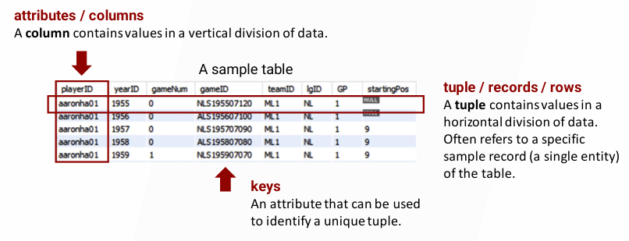
DATABASE

Slide 5
IMPORTANT OF DATABASES
Support business operations.
Enable decision making through analytics.
Ensure data security and integrity.

Slide 6
DATABASE APPLICATIONS
Banking – customer accounts, transactions
E-commerce – product catalogs, orders, payments
Healthcare – patient records, prescriptions
Social Media – posts, analytics

Slide 7
TYPES OF DATA
Structured data (tables, rows, columns)
Semi-structured (XML, JSON)
Unstructured (images, videos, text)

Slide 8
DATABASE EVOLUTION
Flat files → Hierarchical DB → Relational DB → NoSQL → NewSQL
From centralized to distributed and cloud databases

Slide 9
RELATIONAL DATABASES
Store/organize data in tables (rows and columns)
Use primary keys and foreign keys
SQL queries for retrieval and manipulation
Examples: MySQL, PostgreSQL

Slide 10
ADVANTAGES OF RELATIONAL DATABASES
Data integrity
Ease of querying with SQL
Normalization reduces redundancy

Slide 11
NON-RELATIONAL DATABASES
Schema-less, flexible, scalable
Types: Document (MongoDB), Key-value (Redis), Column (Cassandra), Graph (Neo4j)
Handle unstructured data
Examples: MongoDB, Cassandra

Slide 12
ADVANTAGES OF NON-RELATIONAL DATABASES
High scalability
Flexible data models
Handles unstructured data

Slide 13
RELATIONAL vs. NON-RELATIONAL COMPARISON
Structure: Tables vs JSON/Key-Value
Query language: SQL vs APIs
Best use: Financial data vs Social data

Slide 14




OVERVIEW OF DATABASE SYSTEM
Database system
DBMS
DB
Users
DB Applications

Slide 15
DATABASE MANAGEMENT SYSTEM (DBMS)
FUNCTIONS:
Data definition language (DDL).
Permits specification of data types, structures and any data constraints.
All specifications are stored in the database.
Data manipulation language (DML).
General enquiry facility (query language) of the data.
Using Structured Query Language (SQL) to produce required information.
Data recovery
Enables the system to restore data lost due to hardware failure, software errors or power outages.
Provides backup and restore facilities to ensure data integrity and continuity.
Data security
Provides access control mechanisms such as authentication (valid users) and authorization (permission to perform operations).
Prevents unauthorized access, protect confidentiality, and maintains data integrity through encryption and audit trail.

Slide 16
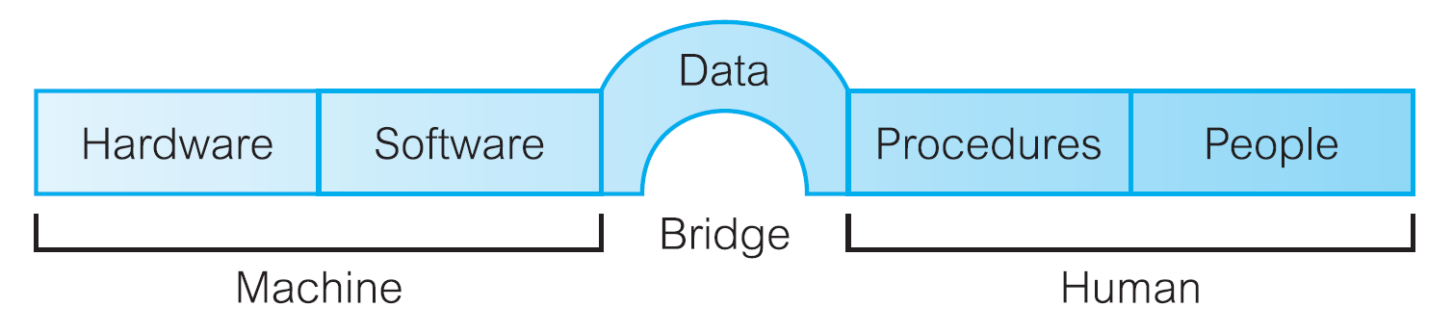
COMPONENTS OF DBMS ENVIRONMENT

Slide 17
TYPES OF DBMS
Hierarchical
Network
Relational (RDBMS) – Oracle, MySQL
Object-oriented
NoSQL DBMS – MongoDB, Cassandra
NewSQL DBMS – VoltDB, NuoDB

Slide 18
USERS OF DBMS
Database administrators (DBAs)
Application developers
End users
System analysts

Slide 19
DATA INTEGRITY
Entity Integrity – uniqueness of rows
Referential Integrity – valid relationships
Domain Integrity – valid values within fields

Slide 20
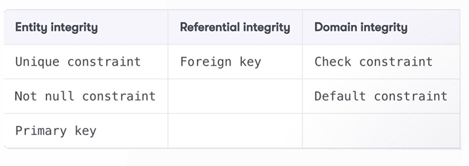
DATA INTEGRITY
Data integrity refers to the consistency and accuracy of the data.
It is typically enforced by the procedures and guidelines in the database design phase.
In RDMS, keys enforce data integrity.
A key is user-defined and forces values in a table to conform to a specified standard (This standard will allow only certain kinds of values to be in the database).
Data integrity refers to the consistency and accuracy of data and table relationships.
The following table lists the types of integrity you can use:

Slide 21
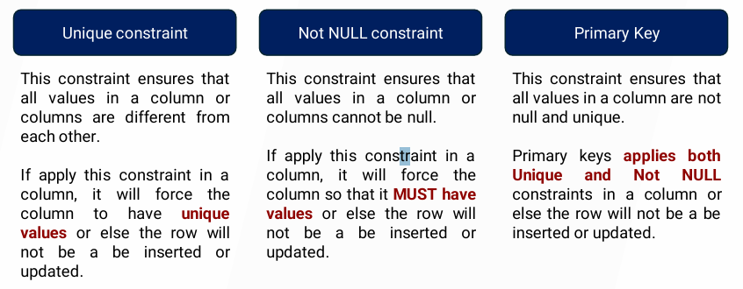
ENTITY INTEGRITY
To ensure that each row in a table is identifiably unique, you use entity integrity.
This is done with a few different types of keys or constraints, including unique, not null, and primary key constraints.

Slide 22
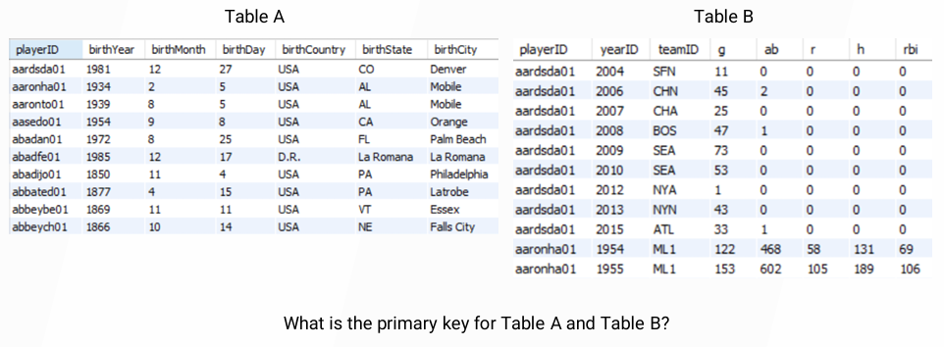
Primary Key

Slide 23
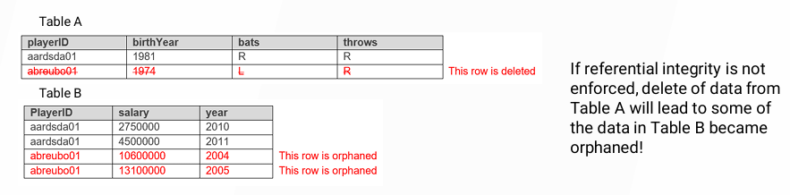
REFERENTIAL INTEGRITY
Referential integrity refers to the consistency and accuracy between tables that can be linked together.
By having a primary key on the parent table and a foreign key on the child table, you achieve referential integrity.
A foreign key on the child table creates a link between one or more columns in the child table and the primary key on the parent table.
When a foreign key is present, it must reference a valid, existing primary key in the parent table.
This way, the data in both tables can maintain a proper relationship.

Slide 24
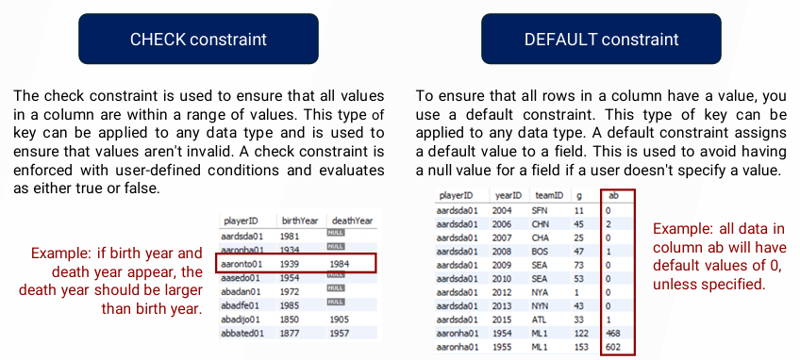
DOMAIN INTEGRITY
To ensure that data values follow defined rules for formatting, range, and value using check and default constraints, you use domain integrity.

Slide 25
CHALLENGES IN DATABASE MANAGEMENT
Security threats
Scalability with Big Data
Performance optimization

Slide 26
MODERN DATABASE TRENDS
Cloud databases
Distributed and parallel databases
Big Data and NoSQL
Integration with AI/ML

Slide 27
SUMMARY
Databases store and manage structured and unstructured data.
Relational vs Non-relational serve different use cases.
DBMS ensures data management, integrity, recovery, and security.
SQL is standard language for relational databases.

Slide 28
EXERCISE 1
Group discussion:
Identify 3 databases used in daily life.
Relational vs Non-relational advantages.
Define database and DBMS.
What is entity integrity?
Why is referential integrity important?

Slide 29


